Slide 1
Mughal Iron & Steel Industries Limited
Presented by:
Mirza Kashif
Abdul Rehman Shoukat
Muhammad Usman
Jehanzeb Shehzad
Zain Khan

Slide 2
Introduction
Mughal Iron & Steel Industries Limited was incorporated in Pakistan as a public limited company in 2010.
The principal activity of the Company is manufacturing and sale of mild steel products relating to the ferrous segment.
The company is present in the long-roll steel industry and engaged in other activities such as making billets, steel rebars, and t-iron.
The company finds the utility of its products in the domestic housing market, both in urban and rural, alike, as well as in large infrastructure projects market.

Slide 3
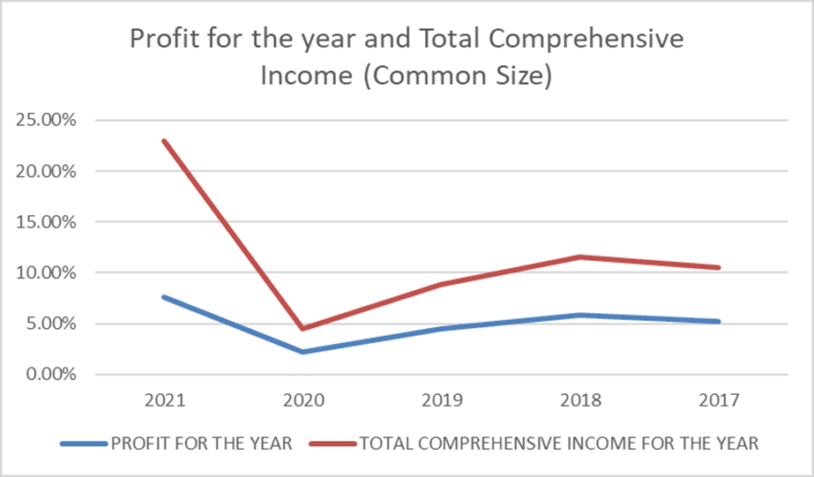
Common-size Analysis Insights
Notes:
The graph below shows the relationship between Profit for the year and Total Comprehensive Income for the year in years 2021 and 2017 of the common size analysis showing that the Profit for the year 2021 as a % of Net sales was a maximum of about 7.63% in 2021 and minimum in 2020 mainly due to low sales due to Covid aftershocks and economy in the recession session. The total comprehensive income for the year was maximum in 2021 of about 15.29% and minimum in 2020 of about 2.28% impacted by related deferred taxes of benefit obligation and revaluation of fixed assets.

Slide 4
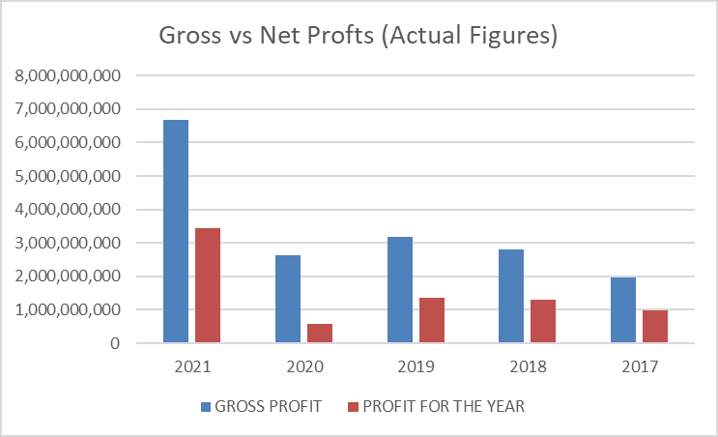
Common-size Analysis Insights (cont.)
Notes:
The graph above shows the comparison of the actual figures for Gross profit and Net Profit. The gross profits and net profits have increased in the years 2017, 2018, and 2019 however they decreased in 2020 and increased again very significantly in the year 2021. The profits went down in the year 2020 majorly due to lower net sales because of covid lockdown restrictions as well as very high finance costs as the long-term debt was highest in 2020 as compared to previous years. Overall, we can see that net profit has stayed around 40-50% of the gross profit except for in the year 2020.

Slide 5
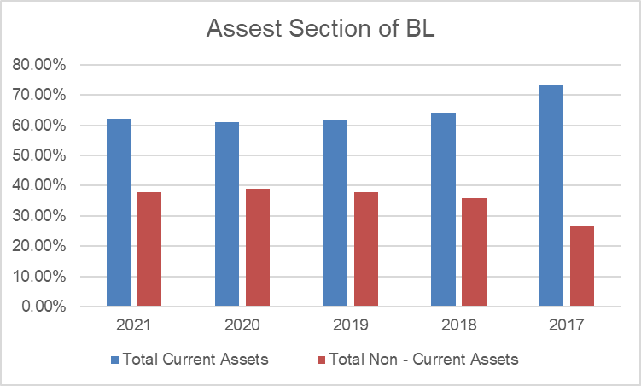
Common-size Analysis Insights (cont.)
Notes:
Around 60-65% of the Total Assets is contributed by Current Assets. Inventory holds the major share of the current assets around 20-35%. Of the inventories Raw Material in transit and in hand contribute the most. In 2019 when Inventories decreased to 25%, Cash and Bank Balances increased to 14% keeping the percentage of overall Current Assets almost constant throughout the five years. Although Current Assets have increased over the years, the percentage of inventories have remained almost the same over the years. Cash and Bank Balances are around 5-12% of the Total Assets. Dues from the Government have also seen some fluctuations and are subject to variation in Sales

Slide 6
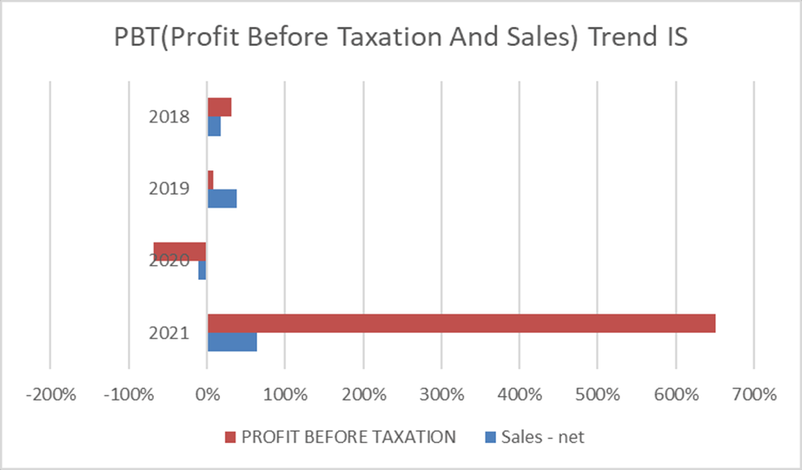
Trend Analysis Insights
Notes:
Profit Before Taxation and Net Sales of the Company in the Trend Analysis as compared to the previous years. The Profit Before Taxation was the Highest in the year 2021-2020 of about 652% whereas the Net Sales grew by 65% in 2021-2020 showing that both of them had a positive growth in 2021-2020. It can be due to charging customer inflation adjusted prices and getting economies of scale which reduced the expenses of the company. 2020-2019 was the year of negative growth in Profit before tax of about -68% and Net Sales of -11% which could be due to Covid factor and a high inflation rate in the country.

Slide 7
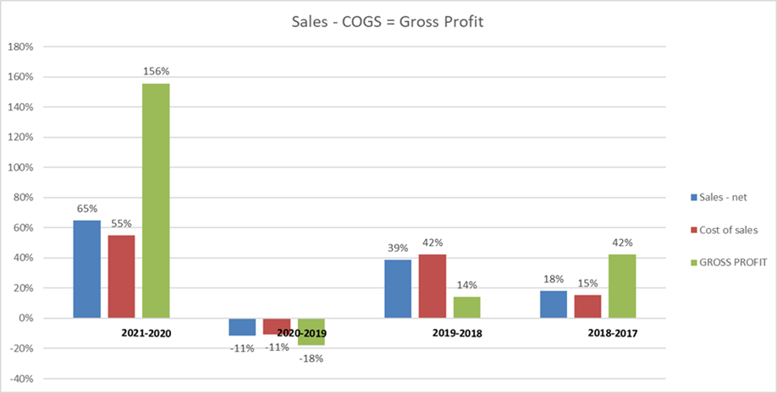
Trend Analysis Insights (cont.)
Notes:
Sales and Cost of Goods sold: There was a major decrease in the year 2019-2020 which could be due to the COVID-19 pandemic and lockdowns that took place. As it can be seen in the graph above, gross Profit has seen various fluctuations over the five years. It increased at a decreasing rate in the years 2017-2019. In the year the lockdown took place Gross Profit change went negative but in the subsequent year it increased majorly by an increase in export sales by 156%

Slide 8
Liquidity Analysis
Notes:
Current Ratio is the Current Assets/ Current Liabilities, it has a decreasing trend as it fell from 1.46 times 2017 to 1.34 times in 2021 it rose to a maximum in 2018 to 1.54 times even though the current assets fell from 73.32 to 63.69 the Current ratio still increased to 1.54. and the minimum was in year 2020 at 1.09 times because of increase in working Capital requirement.
Acid Test Ratio: It compares a companies short term assets to short term liabilities to see if the company has enough cash to pay back its immediate liabilities. It also had a decreasing trend form .76 times in 2017 to .58 times in 2021 with max in year 2019 at .79 times Both Current Assets and Current Liabilities decreased but Liabilities decreased more so Current ratio increased in 2019 and minimum at year 2020 at .53 as current liabilities increased due to increase in working capital requirement.

Slide 9
Notes:
Days Sales in Receivable is calculated by dividing the number of days in the year by the accounts receivable turnover ratio has also an increasing Trend as the Days Increased from 25 to 42 between 2017-2021 having the maximum no of days in 2021 at 42 because in 2021 it had a 141.02% increase in trade debts and mainly due to increase in overall sales revenue and sales rate causing the days to rise to 42. all of them are good indicators as below 45days the turnover is good further more the days sales in receivables is lowest in 2018 at 20 days because there are many trade debtors of the company that none of them have more than 10% of outstanding trade debts and majority are long term customers for more than 5 years with no bad debts.
Inventory Turnover is the rate that inventory stock is sold, or used, and replaced. It had an decreasing but somewhat consistent trend as it only rose greatly in 2019 to 4.05 times but was between 2.5 and 3.5 times in 17-21. It rose that much in 2019 because majority raw material inventory was converted in finished goods incventory and sold in the market as inventory decreased from 5917 million to 5620 million

Slide 10
Capital Structure and Solvency
Notes:
The Total debt ratio measures the amount of leverage used by a company in terms of total debt to total assets. It had an increasing trend between 2017 to 2021 as it rose from .48 times to .63 times, highest in 2020 at .70 due to never defaulting in any payments of its debtor likely to default in future so getting more debt easily and minimum at year 2017.

Slide 11
Notes:
Total debt to equity capital shows the company financial leverage with an increasing trend from .93 times in 2017 to 1.68 in 2021 with max in 2.34 times in 2020 as the company is in the process of expansion and investing huge amounts in terms of capital expenditure so Long Term Debts. The long term debt to Equity capital ratio also having a increasing trend and it also is maximum in 2020 as the company has never defaulted ever so investors are confident and give debt or capital for expansion.

Slide 12
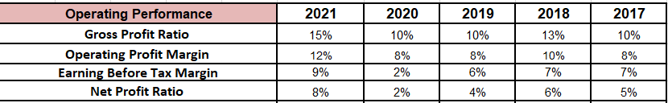
Operating Performance
Gross Profit Margin had an increasing Trend – Cost of sales declining
Earning Before Tax Margin had an increasing trend – Increase ion taxation
Net profit ratio rising – all time low in 2020

Slide 13
Operating Performance: Graphical Analysis

Slide 14

Return on Investment
ROCE had an increasing trend
RNOA kept increasing
ROA had an increasing trend

Slide 15
Return On Investment

Slide 16
ASSET UTILIZATION ANALYSIS
Notes:
Asset utilization is a ratio that measures how efficient an organization is in using the assets to make money and turn a profit. In a manufacturing facility, it would measure how well you are using your installed production capacity.

Slide 17
ASSET UTILIZATION ANALYSIS
ASSET UTILIZATION ANALYSIS | 2021 | 2020 | 2019 | 2018 | 2017
ASSET TURNOVER = (Sales/AvgAssets) | 1.36 | 1.09 | 1.37 | 1.21 | 2.23
INVENTORY TURNOVER | 2.65 | 3.12 | 4.05 | 2.73 | 2.90
AVREAGE OPERATING ASSET TURNOVER | 1.37 | 1.10 | 1.40 | 1.23 | -
ACCOUNT RECEIVABLE TURNOVER | 8.55 | 12.51 | 9.33 | 17.59 | 13.96
Notes:
Asset Turnover ratio: measures the value of a company's sales or revenues relative to the value of its assets. The asset turnover ratio can be used as an indicator of the efficiency of how a company is using its assets to generate revenue. The higher the asset turnover ratio, the more efficient a company is at generating revenue from its assets and vice versa. For every rupee in assets, Mughal steel generated 1.4 rupees in sales in 2021. They have this ratio to a maximum of 2.2 in 2017. This has fallen since and currently is at 1.4. the decrease in 2021 could be attributed to procurement of new plant in 2021 and increasing of inventories due to fall in sales in the year 2020 has increased the total Assets by 65% which is quite a lot.
Inventory Turnover: is a financial ratio showing how many times a company has sold and replaced inventory during a given period. Since Mughal Steels produces a bulky, heavy and high cost product therefore it has gone to a maximum to 4.1 times in 2019 and has remain around 3-2.5 over the other years.
Average OA turnover: The operating asset turnover ratio is an efficiency ratio that identifies the revenue generation capabilities of a company’s operating assets. It shows for every 1 rupee invested in Operating Assets how much sales the company is able to generate. The AVREAGE OPERATING ASSET TURNOVER for Mughal steel stayed between 1.2-1.4 times. The increase in avg operating asset turnover from 1.1 in 2020 to 1.37 in 2021 could be due to increase in sales by 65%. The lowest avg operating asset turnover in 2020 could be due to major decrease in sales by 11%.

Slide 18
ASSET UTILIZATION ANALYSIS
Notes:
Account receivable turnover: Accounts receivable turnover shows the number of times per year that a business collects its average accounts receivable. The general rule of thumb is that the higher the accounts receivable turnover rate the better. A higher ratio, therefore, can mean:
You receive payment for debts
Your collections methods are effective.
Lesser chances of bad debt.
The turnover ratio was quite high until 2018 which fell in 2019 and 2020 exponentially probably because the debtors were unable to repay their debts due to bad business conditions in the covid period. However, the acc rec turnover ratio did not improve in 2021 as well probably because Mughal steel have started giving credit too leniently.

Slide 19
Market Measures
Market Measures | 2021 | 2020 | 2019 | 2018 | 2017
P-E RATIO | 8.12 | 16.9 | 4.61 | 12.2 | 19.18
EPS (EARNINGS PER SHARE) | 12.85 | 2.25 | 5.46 | 5.13 | 4.2
EARNING YEILD | 0.12 | 0.06 | 0.22 | 0.08 | 0.05
DIVIDEND YEILD | 3% | - | 5% | 4% | 3%
DPS | 3 | - | 1.2 | 2.2 | 2.6
CAPITAL YEILD | 161.79% | 58.51% | -59.79% | -22.49% | 20.15%
DIVIDEND PAYOUT RATIO | 23% | - | 22% | 43% | 62%
Notes:
Market measure ratios show the relationship between the firm's market value that is measured by the current stock price and certain accounting values to asses the risk and return related with the firm
Price to earnings ratio: is the ratio for valuing a company that measures its current share price relative to its earnings per share (EPS). The Metal and Mining industry was trading at a PE ratio of 6.9 as of 31st December 2021 which tells us that the shares of Mughal Steel were preforming better than the industry.
Earning Yield: Against each one rupee charged by the shareholders, Rs. 0.12, Rs. 0.06, Rs. 0.22, Rs. 0.08 and Rs. 0.05 of net income is earned by each share in the years 2021, 2020, 2019, 2018 and 2017 respectively. The earning yield for Mughal Steel increased in the years 2017 and 2018 due to higher PE ratio in its net income. For the year 2019, the earning yield increased to Rs. 0.22 due to lower PE ratio which was due to lower sales and hence net income. Since the EPS decreased in the year 2020 because of lower net income due lesser sales owing to Covid-19, the earning yield also fell. Lastly, in the year 2022, the earning yield increased again due to higher PE ratio because of higher net income.
Dividend Yield: Against each one rupee invested by the shareholders, Rs. 0.03, Rs. 0, Rs. 0.05, Rs. 0.04 and Rs. 0.03 of dividends has been earned by each share in the years 2021, 2020, 2019, 2018 and 2017 respectively. The dividend yield for Mughal Steel increased in the years 2017 and 2018 due to increase in the DPS. The dividend yield for Mughal Steel also increased in the year 2019 despite a lower DPS due to a huge decrease in its stock price from Rs. 62.57 in 2018 to Rs. 25.16 in 2019. However, the dividend yield for Mughal Steel decreased in the year 2021 due to high stock price as the stock price for Mughal Steel jumped from Rs. 39.88 in 2020 to Rs. 104.40 in 2021.
DPS: The company has paid a dividend of Rs. 3, Rs. 0, Rs. 1.2, Rs. 2.2 and Rs. 2.6 for every common stock outstanding in the years 2021, 2020, 2019, 2018 and 2017 respectively. The company paid a dividend of Rs. 0 in the year 2020 since it had lowest ever profited from the last 10 years due to Covid-19. On the other side, the company paid a dividend of Rs. 3 in the year 2021 since it had the highest profit . The company increased it’s DPS from the year 2017 to 2018 due to an increase in its net income.
Dividend Pay-out Ratio: The company distributed 23%, 0%, 22%, 43% and 62% of it’s net income as dividends in the years 2021, 2020, 2019, 2018 and 2017 respectively. The company had increased dividend pay-out ratio due to high DPS in the year 2017 and 2018. In the year 2019, since the DPS was low, therefore the dividend pay-out ratio was also low. In 2020, since there were no dividends the dividend pay-out ratio was also 0. Lastly, in the year 2021, although the dividends were higher than the previous 5 years, however, the dividend pay-out ratio came out to be lower due to very high net income
Capital Yield: Capital yield is the percentage price appreciation or depreciation on an investment. The capital yield for Mughal Steel was 161.79%, 58.51%, -59.79%, -22.49% and 20.15% for the years 2021, 2020, 2019, 2018 and 2017 respectively. This shows the gain/loss if the shares for Mughal Steel were traded in the following years.

Slide 20
Market Measures
Notes:
EPS: The EPS measures the amount of net income less preferred dividends earned per share. There has been a drastic increase in the company’s earnings per share as it has increased from Rs. 2.25 to 12.85 from 2017 to 2021. The EPS increased from the year 2017 to 2019 majorly due to an increase in the net profit and decreased in 2020 due to lower net income and increased again in 2021 exponentially due to and exponential increase in net income.

Slide 21
As an Investor
Notes:
From an investors point of view we would focus on market measures to base a decision of investing or not. The price of Mughal steel share has been more than 20 but has fluctuated around 40 and 100. The price earning ratio for has been decreasing which could mean that the company’s stock is highly undervalued. Eps has increased and earning is also growing with a shock in 2020 due to pandemic. DPS has also increased, Capital yield has also increased significantly in 2021 and the dividend payout ratio is also a decent number which as an investor could mean a stream of income.
From an investors POV, Mughal steel seems very promising and could be a good investment.

Slide 22
As a Creditor
Notes:
Liquidity refers to the ability of an enterprise to meet its short-term financial obligations. First of all looking at the net working capital it is positive for all years therefore they had enough current assets to cover their short term obligations which is also reassured by current ratio being greater than 1. As a creditor to Mughal steel the cash to current assets ratio raises an alarm as it is quite small, also the increasing days sales in reciveables and increasing operating cycle is also a matter of concern as this could be an indicator of a weak recovery department. Day sales in inventory could be justified with the large scale of production they carry out so it could be high. Net trade cycle also has increased significantly from 36 to 105 days which is also reduces confidence in giving Mughal Steel credit. They have also generated very less cash against current liabilities as depected by Cashflow measure therefore as a Trade creditor we would not give it credit as it has low liquid assets and although current assets are more than current liabilities but cash assets are less and there is likely to delay on payments.

Slide 23
As a Creditor

Slide 24
Recommendations
Try to decrease the days sales in Receivable as it has rose to 42 in 2021 from 25 in 2017, improve recovery department.
Take less debt as country economic condition are deteriorating a major shock can lead to major crisis
Reduce costs and expenses to increase Profit.
Utilise or Sell off Idle assets
Increase Liquid assets to increase confidence of trade creditors in the company

